Slide 1
ADGen: A Multimodal Advertisement Generation Dataset and Video Captioning Framework
Paper ID: 417
Pragathi Y P S Swaroop Bharadwaj Preetham Kolli S Sanjith Kavitha Sooda Sunayana S
B.M.S. College of Engineering, Bangalore
3rd International Conference on Advances in Data-driven Computing and Intelligent Systems (ADCIS 2024)
BITS Pilani, K K Birla Goa Campus, India

Slide 2
OUTLINE
Introduction
Related Works
Proposed Captioning Methodology
ADGen Dataset
Result Discussion
Limitations
Future Work
Conclusion
References

Slide 3
INTRODUCTION
In today's digital landscape, video content plays a vital role in advertisement generation and product marketing.
Videos - powerful media for influencing consumer behavior.
More and more companies are employing GenAI tools to develop video content.
Major Findings:
Novel Multimodal Pipeline
Effective Capture of Contextual Details
New AD Dataset Contribution

Slide 4
Research Gap
Several notable challenges for video datasets compared to image datasets.
Higher costs and complexities associated with video collection.
Current datasets often feature simple, short text captions that fail to encapsulate the details in visual information.
Lack of video processing datasets that cater to Automated Advertisement generation.

Slide 5
Related Works
Dataset | Description | Size | Notable Features | Limitations
UCF-101 | Videos of human actions in multiple categories. | 13,000 videos, 101 categories | Benchmark for human action recognition | Limited to human actions
HowTo100M | Instructional videos covering various activities. | 136M clips, 23,000 activities, 1.2M videos | Large-scale instructional video dataset | Focused on instructional content
MSR-VTT | Web video clips with paired textual descriptions. | 10,000 videos, 200,000 clip-sentence pairs | Benchmark for video-to-text generation | Limited contextual understanding
HD-VILA-100M | High-resolution, diverse video-language dataset. | 3.3M videos, 100M sentences, 15 categories | High-quality, multimodal data for various tasks | Not specific to video ads
Ad Video Dataset | Curated TV ad dataset with metadata. | 14,490 video clips (2006-2016, Japan) | Rich metadata (ad categories, broadcasting, etc.) | Lacks multimodal integration for video creation
Notes:
Modality for all of these = Video , Text

Slide 6
Related Works
Framework | Key Innovations | Techniques Used | Limitations
Multimodal Video-Captioning Model | Integrates audio, external knowledge, and attention mechanisms to improve captioning. | Audio, external knowledge, attention mechanisms | Dependency on high-quality external knowledge for effectiveness
Stacked Multimodal Attention Network | Incorporates visual and textual historical information for context-based captioning. | Multimodal attention, visual/textual context | Limited scalability to longer video durations
Reinforcement Learning-based Captioning | Uses reinforcement learning to prioritize and refine information during captioning. | Reinforcement learning, content prioritization | Can be computationally intensive
DWT-CNN with Multimodal Attention | Leverages Discrete Wavelet Transform-based CNN for capturing spatial, spectral, and semantic details. | Wavelet CNN, global/contextual/temporal attention | High model complexity, requires more computation
MR-VPC (Missing Resistant-VPC) | Integrates video, speech, and event boundaries; uses DropAM and DistillAM for missing modality scenarios. | DropAM, DistillAM, video/speech/event boundaries | May require more complex training for missing data scenarios

Slide 7
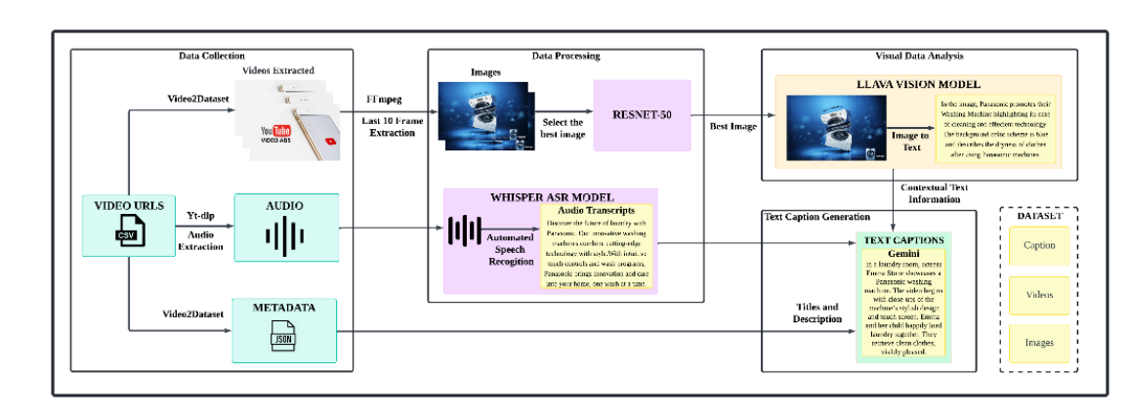
PROPOSED CAPTIONING METHODOLOGY
Figure Dataset Creation Pipeline

Slide 8
PROPOSED ADGEN DATASET
The proposed dataset comprises 720 videos sourced from the Youtube-8M dataset, which was extensively processed through the presented pipeline.
The total duration of the dataset is approximately 24 hours.
Each video is accompanied by its corresponding text captions and images, rendering it a rich multimodal resource for advertisement video generation and related tasks.

Slide 9
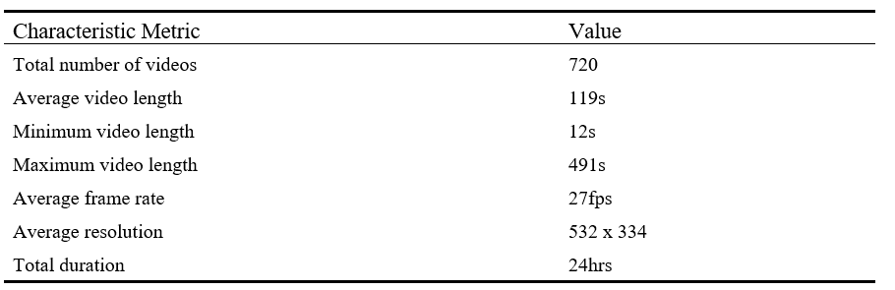
PROPOSED ADGEN DATASET

Slide 10
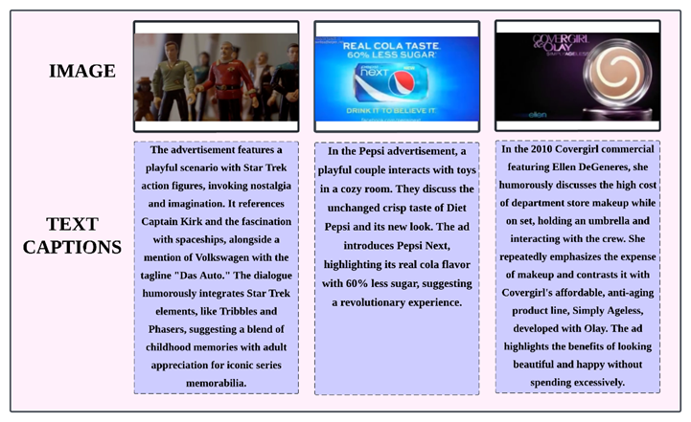
The figure shows image samples from the multimodal advertisement generation dataset and the corresponding text captions generated using the video-to-text pipeline. It can be seen that the text captions include the backdrop of the scene such as “toys in a cozy room,” “scenario with Star Trek Action Figures,” while the actions such as “discusses the high cost,” “interacting with the crew,” “couple interacts with toys” are observed in the language of the text captions. Additionally, product taglines that are vital for an ad are captured such as “Das Auto” and emphasize the personalities, and places in the scene.

Slide 11
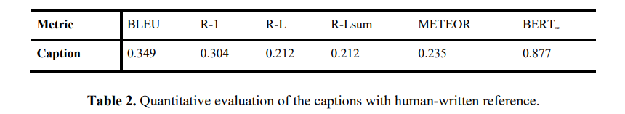
RESULT DISCUSSION
Quantitative Evaluation
In video captioning, evaluating the quality of generated captions against human-written reference captions were crucial. Thus, six popular metrics were utilized for this purpose.

Slide 12
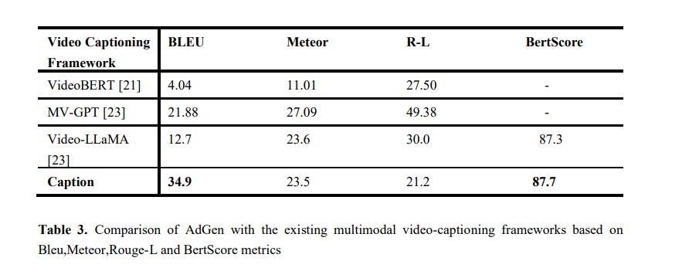
RESULT DISCUSSION
2. Comparison with previous works

Slide 13
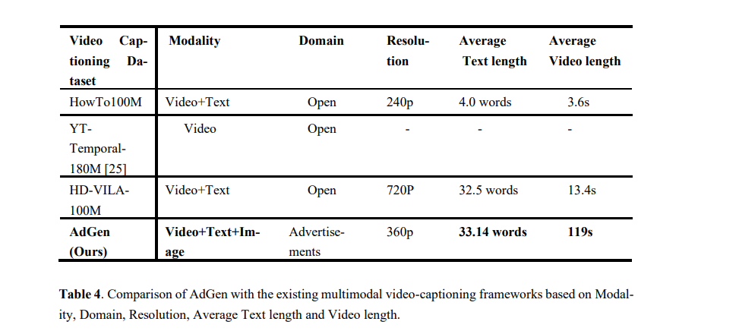
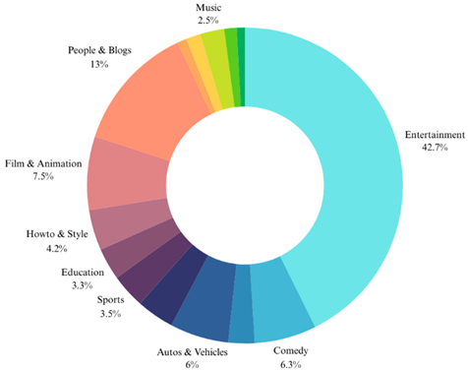
RESULT DISCUSSION
2. Comparison with previous works

Slide 14
LIMITATIONS
Despite its advancements, the system has a few limitations:
Relatively low compared to the high-resolution advertisements.
Shorter average length of the videos.
Addressing videos with multiple ads, which complicates the generation of accurate captions for each segment.

Slide 15
CONCLUSION
This paper introduces a novel multimodal video captioning pipeline and multimodal Ad dataset tailored for the advertisement domain.
By integrating advanced technologies, the system effectively captures intricate action sequences and contextual details.
Potential enhancements include splitting videos with multiple ads into individual segments, allowing for more precise captioning.
Looking ahead, this pipeline holds significant potential for applications such as text-to-video generation, video-based question answering, and automating the captioning process for companies, enabling faster and more consistent content creation.

Slide 16
REFERENCES
1. Kaiming He et al., “Deep Residual Learning for Image Recognition” in IEEE Conference on Computer Vision and Pattern Recognition (CVPR), 2016
2. Liu H, Li C, Wu Q, Lee YJ (2024) “Visual instruction tuning”.In: Advances in neural information processing systems 36
3. Gemini Team Google (2023).” Gemini: A Family of Highly Capable Multimodal Models” in arXiv:2312.11805[cs.CL]
4. S. Abu-El-Haija et al., "YouTube-8M: A Large-Scale Video Classification Benchmark," in Proceedings of the 2016 ACM on Multimedia Conference (MM), 2016.
5. Tian Y, Guan C, Goodman J, Moore M, Xu C (2019) Audio-Visual Interpretable and Controllable Video Captioning. In: CVPR Workshops
6. Varma S, James D (2021) An efficient deep learning‐based video captioning framework using multi‐modal features. Expert Systems. https://doi.org/10.1111/exsy.12920
7. Zheng Y, Zhang Y, Feng R, Zhang T, Fan W (2022) Stacked Multimodal Attention Network for Context-Aware Video Captioning. IEEE Transactions on Circuits and Systems for Video Technology 32:31–42. https://doi.org/10.1109/TCSVT.2021.3058626
8. R. S. Bhooshan and S. K., "A Multimodal Framework for Video Caption Generation," in IEEE Access, vol. 10, pp. 92166-92176, 2022, doi: 10.1109/ACCESS.2022.3202526
9. Sishuo Chen et al., “Towards Multimodal Video Paragraph Captioning Models Robust to Missing Modality”, in arXiv:2403.19221 [cs.CV]
10. Khurram Soomro et al., “UCF101: A Dataset of 101 Human Actions Classes From Videos in The Wild”, in arXiv:1212.0402 [cs.CV]
11. A. Miech, D. Zhukov, J. -B. Alayrac, M. Tapaswi, I. Laptev and J. Sivic, "HowTo100M: Learning a Text-Video Embedding by Watching Hundred Million Narrated Video Clips," 2019 IEEE/CVF International Conference on Computer Vision (ICCV), Seoul, Korea (South), 2019, pp. 2630-2640
12. J. Xu, T. Mei, T. Yao and Y. Rui, "MSR-VTT: A Large Video Description Dataset for Bridging Video and Language," 2016 IEEE Conference on Computer Vision and Pattern Recognition (CVPR), Las Vegas, NV, USA, 2016, pp. 5288-5296

Slide 17
REFERENCES
13. H. Xue et al., "Advancing High-Resolution Video-Language Representation with Large-Scale Video Transcriptions," 2022 IEEE/CVF Conference on Computer Vision and Pattern Recognition (CVPR), New Orleans, LA, USA, 2022, pp. 5026-5035
14. Z. Hussain et al., "Automatic Understanding of Image and Video Advertisements," in 2017 IEEE Conference on Computer Vision and Pattern Recognition (CVPR), Honolulu, HI, USA, 2017 pp. 1100-1110.
15. Tao, L., Nakamura, S., Wang, X. et al. A large-scale television advertising dataset for detailed impression analysis. Multimed Tools Appl 83, 18779–18802 (2024).
16. Alec Radford et al.,(2022) “Robust speech recognition via large-scale weak supervision”, presented at ICML'23: Proceedings of the 40th International Conference on Machine Learning.
17. C. Lin, "ROUGE: A Package for Automatic Evaluation of Summaries,", presented at the Text Summarization Branches Out: Proceedings of the ACL-04 Workshop, 2004.
18. C. Papineni, K. Roukos, T. Ward, and W. Zhu, "BLEU: a Method for Automatic Evaluation of Machine Translation," in Proceedings of the 40th Annual Meeting on Association for Computational Linguistics (ACL), 2002.
19. Tianyi Zhang et al., “BERTScore: Evaluating Text Generation with BERT”, presented at the ICLR,2024.
20. Satanjeev Banerjee and Alon Lavie. 2005. METEOR: An Automatic Metric for MT Evaluation with Improved Correlation with Human Judgments. In Proceedings of the ACL Workshop on Intrinsic and Extrinsic Evaluation Measures for Machine Translation and/or Summarization, pages 65–72, Ann Arbor, Michigan. Association for Computational Linguistics.
21. C. Sun, A. Myers, C. Vondrick, K. Murphy and C. Schmid, "VideoBERT: A Joint Model for Video and Language Representation Learning," in 2019 IEEE/CVF International Conference on Computer Vision (ICCV), Seoul, Korea (South), 2019 pp. 7463-7472, doi: 10.1109/ICCV.2019.00756.
22. Paul Hongsuck Seo et al., “End-to-end Generative Pretraining for Multimodal Video Captioning”, in arXiv:2201.08264 [cs.CV].
23. Hang Zhang, Xin Li, and Lidong Bing. 2023. Video-LLaMA: An Instruction-tuned Audio-Visual Language Model for Video Understanding. In Proceedings of the 2023 Conference on Empirical Methods in Natural Language Processing: System Demonstrations, pages 543–553, Singapore. Association for Computational Linguistics.
24. Rowan Zellers, Ximing Lu, Jack Hessel, Youngjae Yu, Jae Sung Park, Jize Cao, Ali Farhadi, and Yejin Choi. MERLOT: Multimodal neural script knowledge models. ZIn Advances in Neural Information Processing Systems (NeurIPS), 2021.

Slide 18
Thank You

